Slide 1
Tonight!
7pm – Bay Reading Room (adjacent to Lillie 203)
Go in the front door of Lillie (steps to left on MBL St as you come from Swope/Ebert), OR
Go in the back door of Lillie, by the water; take the elevator up to floor 2/Library.

Slide 2
Metagenomics and k-mers (Day 2)
Titus Brown
MBL STAMPS 7/22/24

Slide 3
Library analogy!
Suppose you stumble across a library from an ancient civilization.
There are many small fragments of scrolls in a room! They are well mixed!
Conveniently you also have access to a card catalog that has one card per scroll with a Dewey decimal system number on each one!
Analogs:
Scroll fragment size: read size
Assembly: rebuilding the scrolls
Mapping: mapping the fragments to modern scrolls or books
K-mers: Analyzing all the words!

Slide 4
Challenges of this "library”
Different book sizes!
Many editions of scrolls!
Different popularities of scrolls!
Different languages may be present, and you may be able to read some, many, or none!
What if: you do not know the boundaries between words/sentences??

Slide 5
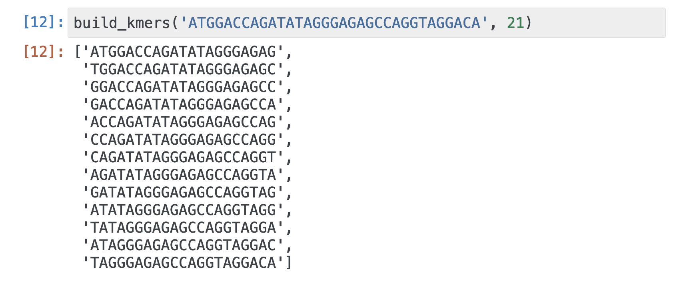
Revisiting: What are k-mers? => WORDS
Fixed-length “words” of DNA that are extracted by sliding a window along sequence.
“k” is the window size.
You can apply this to fragments! Or books/scrolls!

Slide 6
Word (k-mer) based analyses:
How similar are these two books (even if I can’t read them)?
How similar are these two different piles of fragments?
I have a book or two or three! How much matches to this pile, and how much is unknown?
(Both flat/non-counting and abund/counting number of fragments a word is in.)

Slide 7
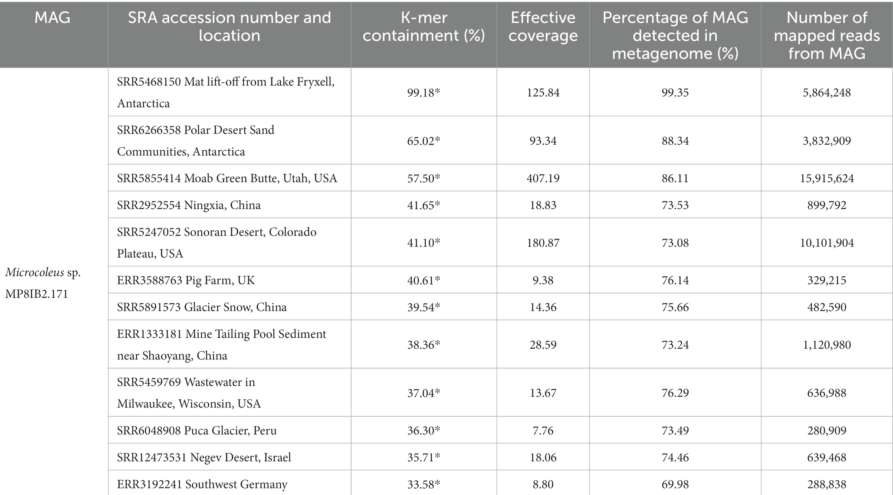
Mapping validation of k-mer hits, from Lumian et al., 10.3389/fmicb.2024.1328083

Slide 8
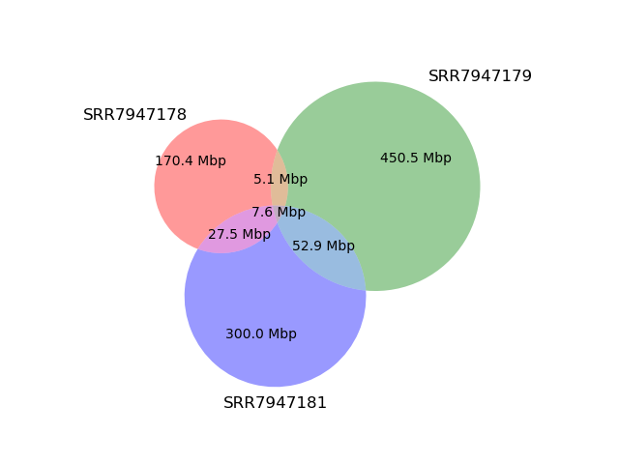
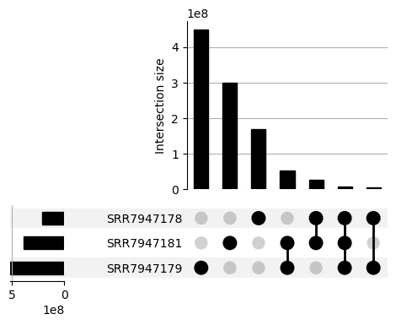
Diagram 1: Metagenome comparison.
K=31, DNA. No abundance.

Slide 10
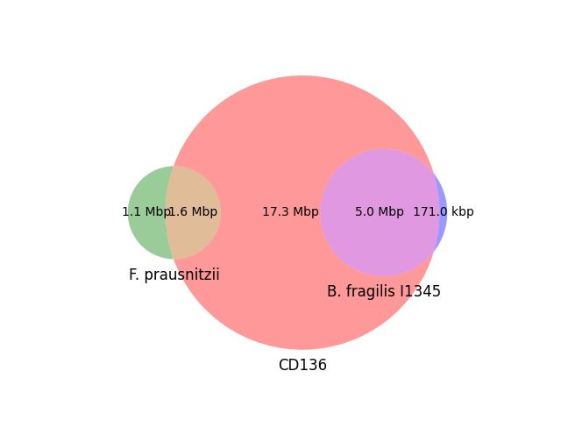
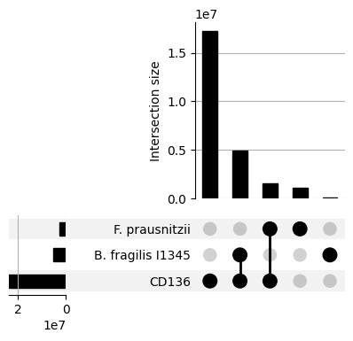
Diagram 2: Genomes and metagenomes
CD136 metagenome subset.
K=31, DNA. No abundance.

Slide 12
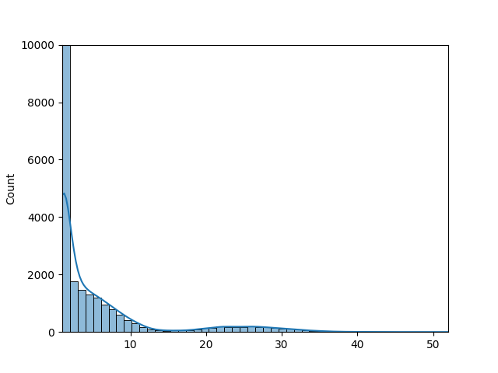
Diagram 3: Abundance histograms of k-mers in metagenomes
CD136 metagenome subset.
K=31, DNA.
With abundance.
Number of k-mers with that multiplicity.
Multiplicity of k-mer (num times observed)

Slide 13
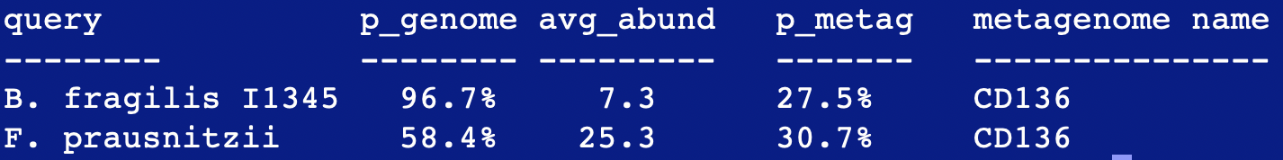

Slide 15
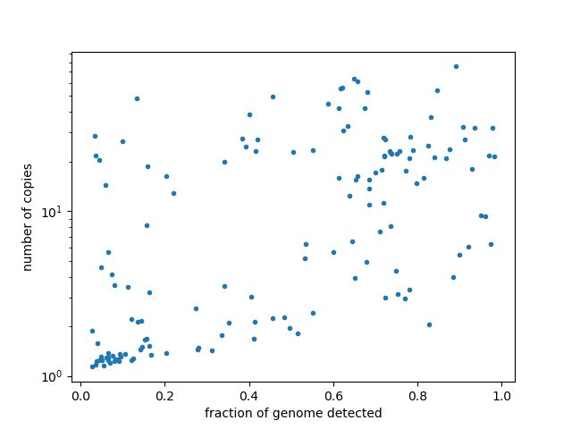
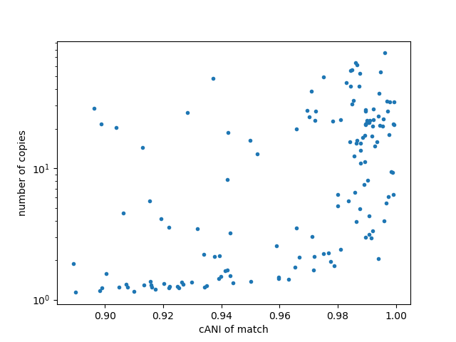
Diagram 4: Which genomes are present in this metagenome?
SRR7947178
K=31, DNA. Abund.
All points are robustly observed under a naïve null model.

Slide 16
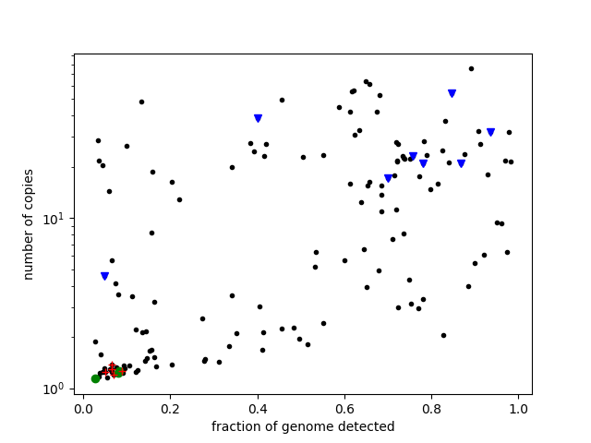
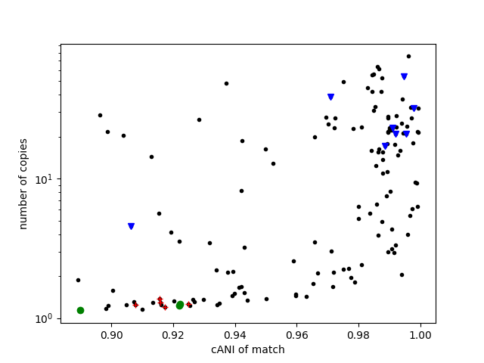
Diagram 4: Which genomes are present in this metagenome?
SRR7947178
K=31, DNA. Abund.
All points are robustly observed under a naïve null model.
Blue triangles: Ruminococcus
Red crosses: Bacteroides
Green circles: Alistipes

Slide 18
Mapping validation of k-mer hits, from Lumian et al., 10.3389/fmicb.2024.1328083

Slide 19
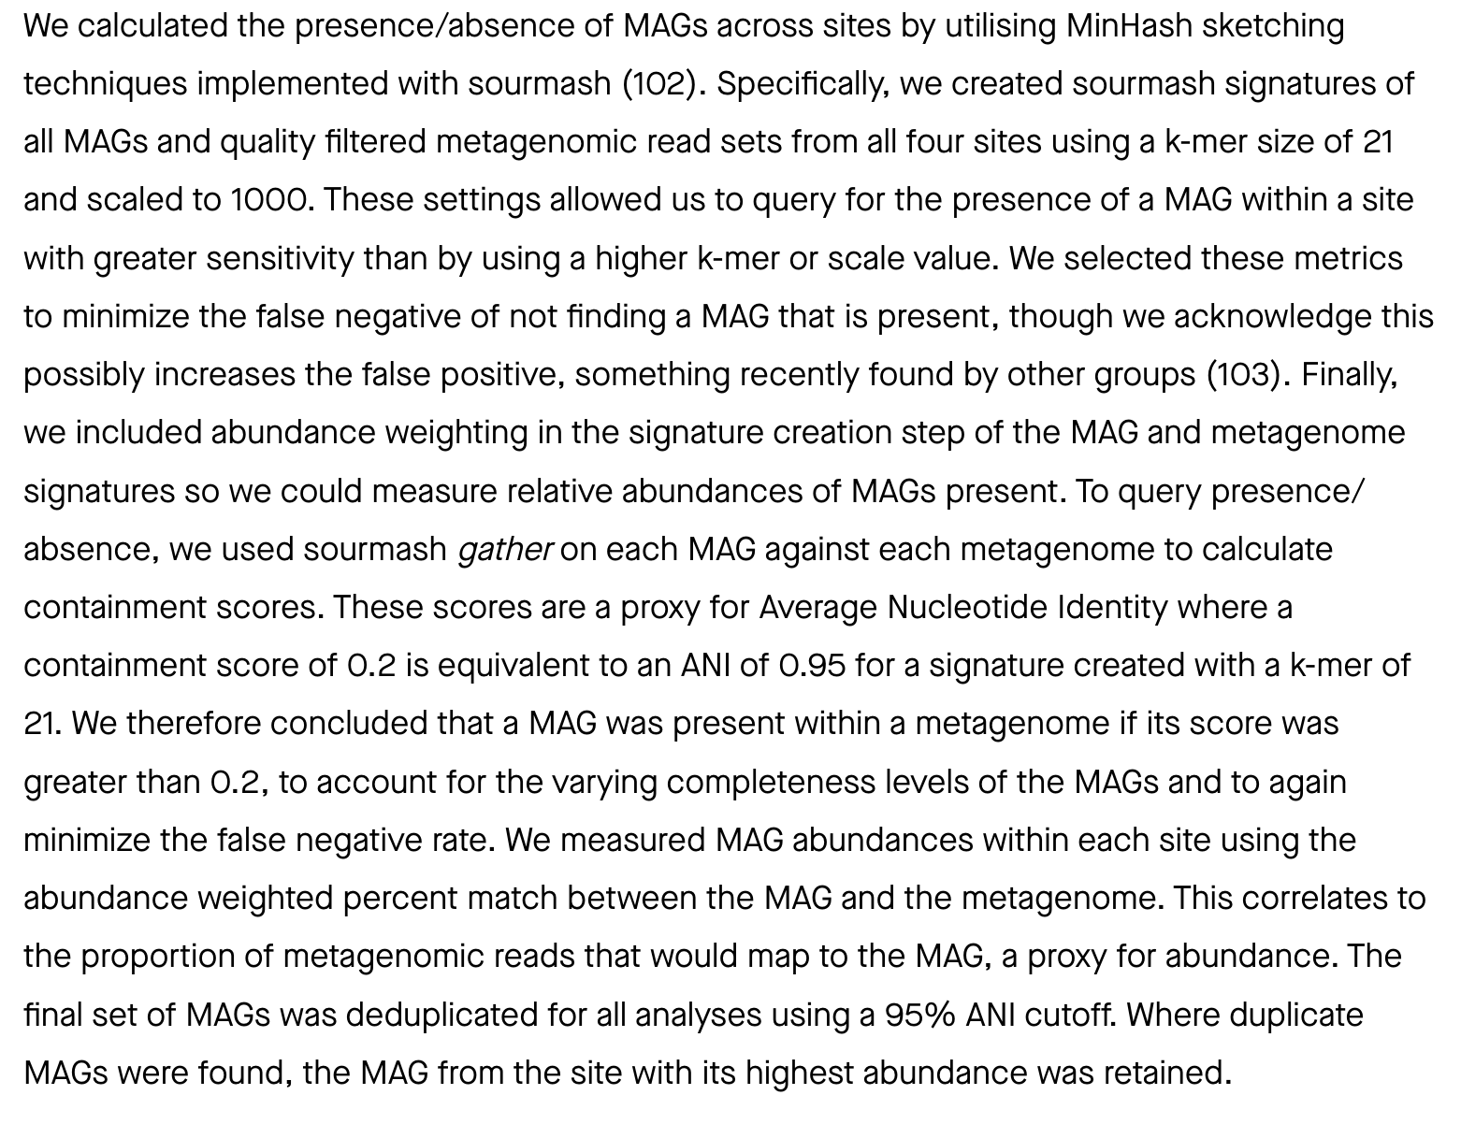
From: doi:10.21203/rs.3.rs-4445835/v1

Slide 20
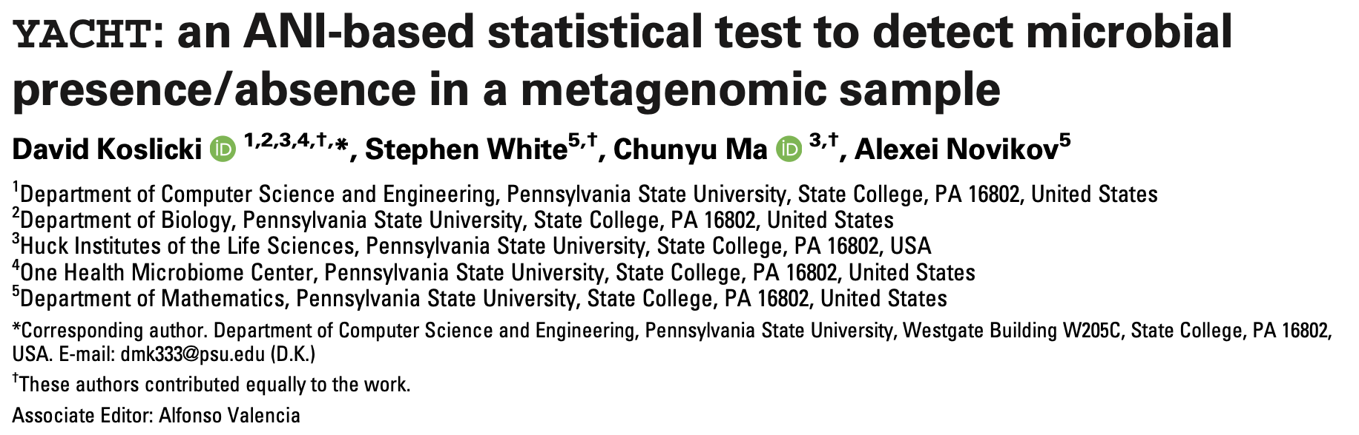
A paper to read…

Slide 21
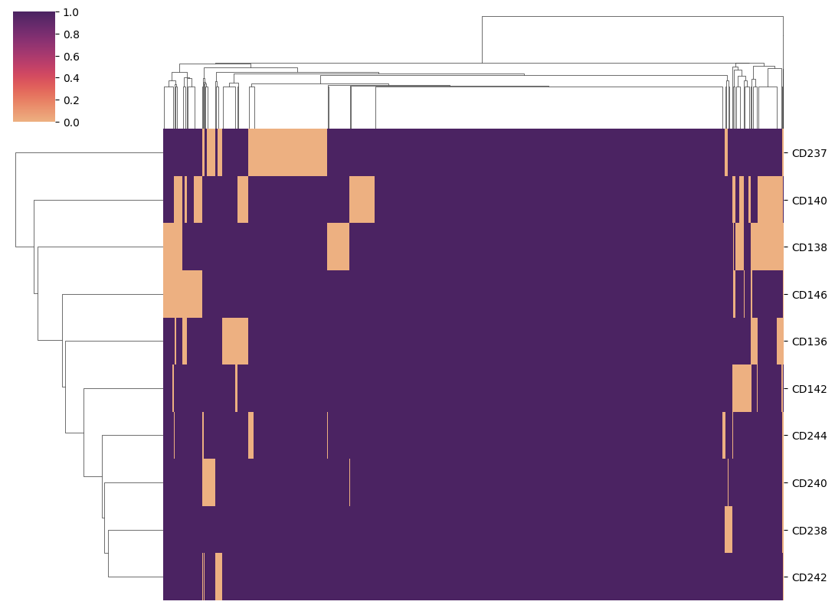
Diagram 5: Presence/absence content plots
K=31, DNA.
10kb regions from known B. fragilis genomes.
No abund.
Metagenome samples
10kb regions (presence/absence)

Slide 23
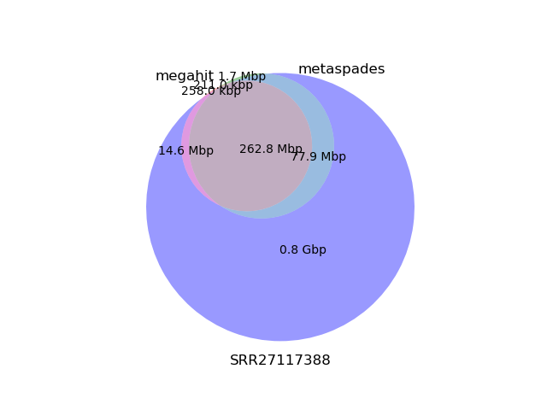
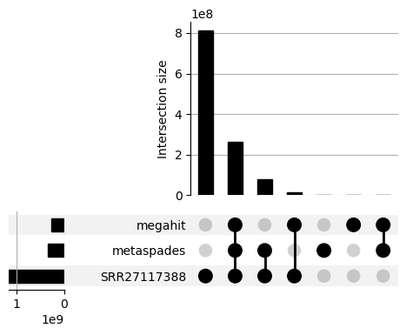
Diagram 6: comparing assembly content

Slide 25
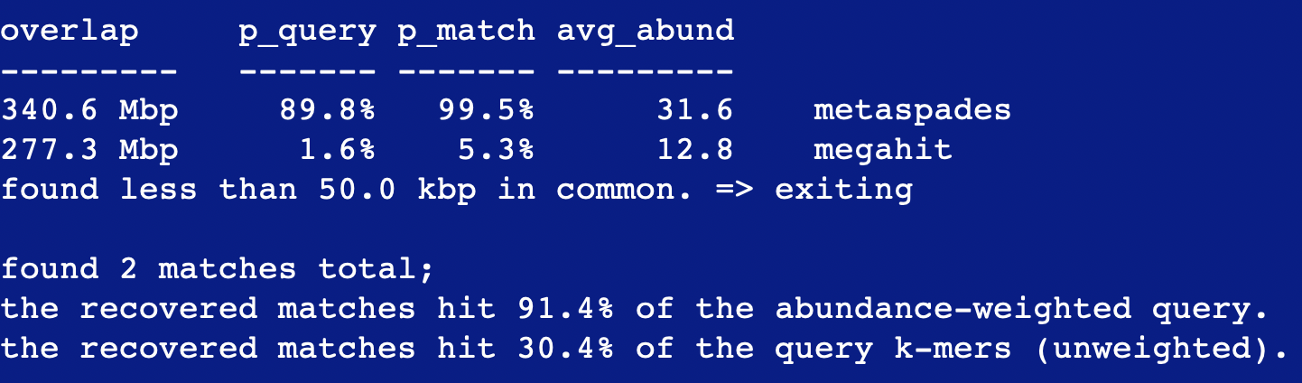

Slide 26
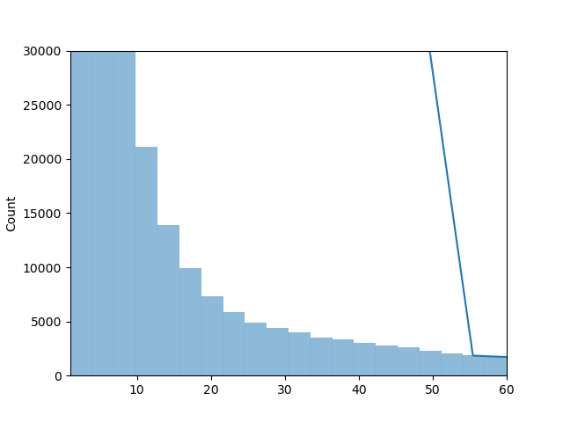
Abundance histogram of SRR27117388
K=31, DNA

Slide 27
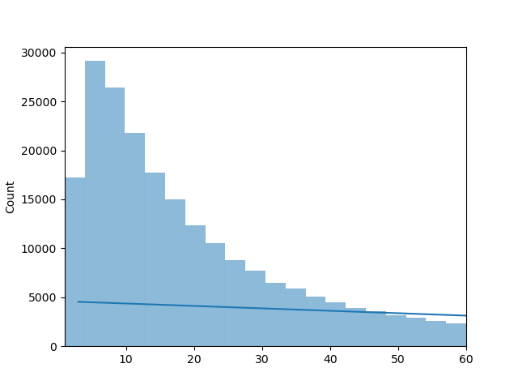
Abundance histogram of k-mers assembled by megahit from SRR27117388
K=31, DNA

Slide 28
Summary of k-mer diagrams and perspective
K-mers can be used to investigate genomes and metagenomes – overlap, containment, similarity
Their measures are different from, but related to, mapping.
However, mapping requires a reference, k-mers do not.
Lots and lots of tools do k-mer analyses; sourmash is just one multitool that Titus likes.

Slide 30
Part (ii): Dude, what’s in my metagenome??
There are 143 genomes from GTDB rs214 detected (via sourmash gather) in SRR7947178.
K=31, DNA. Abund.
Blue triangles: Ruminococcus
Red crosses: Bacteroides
Green circles: Alistipes

Slide 31
My (our!) goal is strain resolved metagenomics.
We want to know which genomes are in my metagenome?
Our solution should be capable of working at large scale - ~million genomes.
Our solution should also deal with the problem of having highly overlapping genomes in the databases.

Slide 32
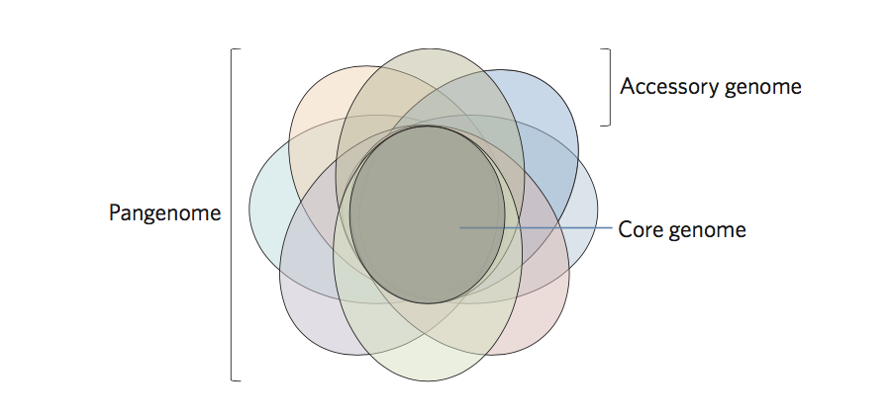
Conceptual challenge: genomes with shared content.
Many genomes share substantial content with other genomes – most especially, because of species pangenomes.
How do you assign metagenome content in this case??
McInerny et al., DOI: 10.1038/nmicrobiol.2017.40

Slide 33
Strain resolved metagenomics is our goal, but also very challenging!
Different strains of the same microbial species may have very different function – e.g. E. coli can be harmless, or can be pathogenic, due to differences in strain content.
Metagenomes always contain mixtures of strains, in practice.
There will inevitably be very large databases of strain information, and there is no good way to condense them!
Strains always have significant overlap with other strains of the same species!

Slide 34
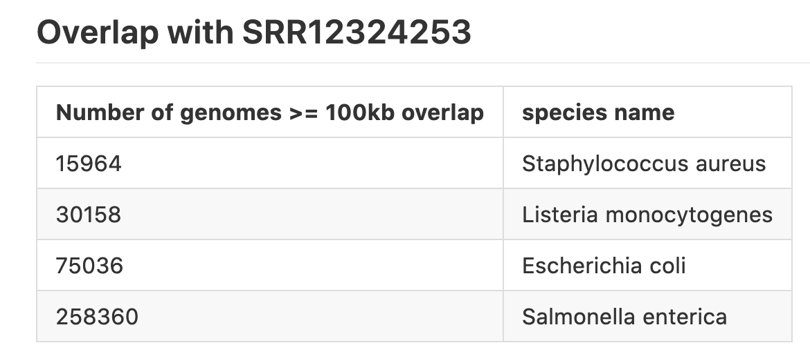
Our genome databases are massively redundant!
e.g. for zymo mock community, SRR12324253, there are many overlapping genomes – but most are redundant!
(using genbank - 700,000 genomes)

Slide 35
I’m going to slightly change the question…
From:
What genomes are in my metagenome?
To:
What is the shortest list of genomes that covers all of the known parts of my metagenome?

Slide 36
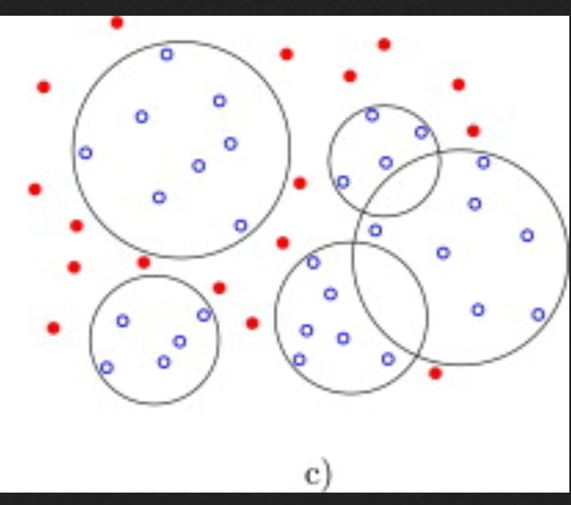
And this turns out to be a well known CS problem - the “min set cover” problem.
By analogy – what’s the smallest set of additional circles that you need to cover the blue dots (== “known” k-mers)?
Figure from Bereg et al., 2012 doi.org/10.1016/j.comgeo.2012.01.014

Slide 37
min-set-cov has a straightforward “best approximate” solution!
Find circle that contains the most points; remove those points; repeat.
(1)
Figure from Bereg et al., 2012 doi.org/10.1016/j.comgeo.2012.01.014

Slide 38
min-set-cov has a straightforward “best approximate” solution!
Find circle that contains the most points; remove those points; repeat.
(2)
(1)
Figure from Bereg et al., 2012 doi.org/10.1016/j.comgeo.2012.01.014

Slide 39
-- and min-set-cov has a straightforward “best approximate” solution!
Find circle that contains the most points; remove those points; repeat.
(2)
(1)
(3)
Figure from Bereg et al., 2012 doi.org/10.1016/j.comgeo.2012.01.014

Slide 40
-- and min-set-cov has a straightforward “best approximate” solution!
Find circle that contains the most points; remove those points; repeat.
(2)
(5)
(1)
(4)
(3)
Figure from Bereg et al., 2012 doi.org/10.1016/j.comgeo.2012.01.014

Slide 41
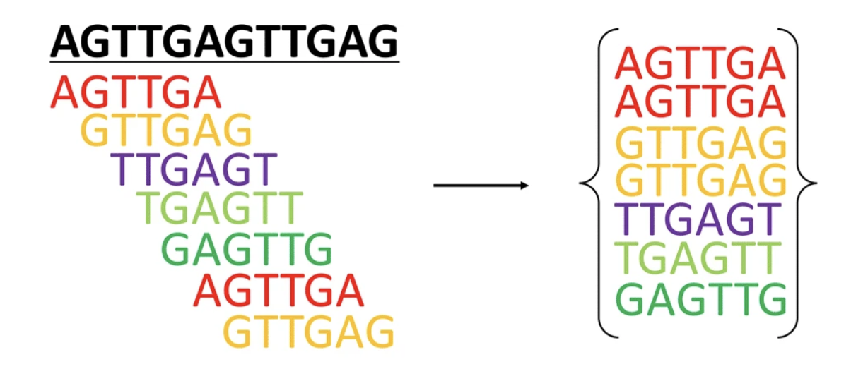
We can implement the min-set-cov algorithm for genomes using k-mers.
(Typically we choose k to be unique at the strain or species level, so k=31 or k=51.)
Figure from Hua and Zhang, BMC Genomics volume 20.

Slide 42
We can implement the min-set-cov algorithm for genomes using k-mers.
Reframed: what is the smallest collection of genomes { G } in database D such that all of the k-mers shared between G and D are in the collection { G }?

Slide 43
Strain-level resolution for queries with k-mers – what’s the smallest set of matches?
No one database genome has all three known accessory elements!
Notes:
Make points about alignability and ANI, vs Jaccard – ANI cannot distinguish ANY of these, containment can. Also, define containment as venn diagrams.

Slide 44
Step 1 – find a “best” match…
(1)
Notes:
Make points about alignability and ANI, vs Jaccard – ANI cannot distinguish ANY of these, containment can. Also, define containment as venn diagrams.

Slide 45
Step 2 – remove best match from query!
(1)
Notes:
Make points about alignability and ANI, vs Jaccard – ANI cannot distinguish ANY of these, containment can. Also, define containment as venn diagrams.

Slide 46
Step 3 – find next best match, remove.
(2)
(1)
Notes:
Make points about alignability and ANI, vs Jaccard – ANI cannot distinguish ANY of these, containment can. Also, define containment as venn diagrams.

Slide 47
…& continue until you run out of matches.
(2)
(1)
(The “novel” bit is not in the database.)
Notes:
Make points about alignability and ANI, vs Jaccard – ANI cannot distinguish ANY of these, containment can. Also, define containment as venn diagrams.

Slide 48
Using k-mers and min-set cov to make a list of genomes in a metagenome.
We frame the challenge of finding the relevant set of genomes as a min-set-cover problem:
What is the smallest collection of genomes { G } in database D such that all of the k-mers shared between G and D are in the collection { G }?
There is a simple & efficient polynomial-time solution!

Slide 49
Our genome databases are massively redundant!
e.g. for zymo mock community, SRR12324253, there are many overlapping genomes – but most are redundant!
(using genbank - 700,000 genomes)

Slide 50
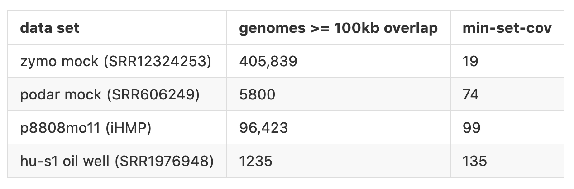
min-set-cov dramatically reduces the list of relevant genomes
Which genomes have significant overlap, vs which genomes are comprise the minimal list of genomes that cover everything?
(using genbank - 700,000 genomes)

Slide 51
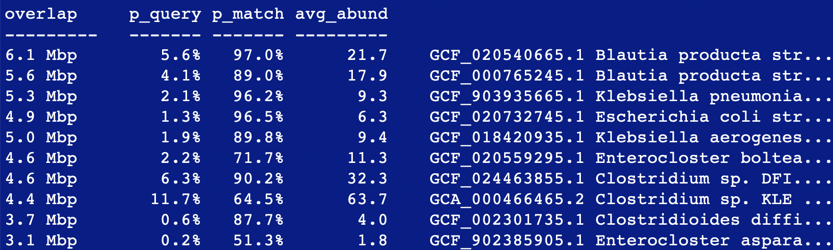
What does this look like in practice??
SRR7947178, k=31, against GTDB rs214

Slide 52
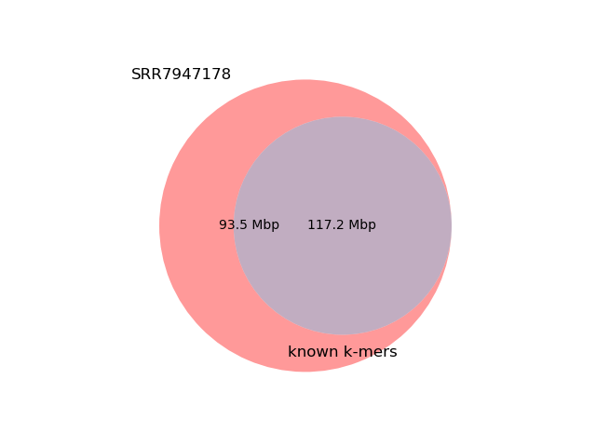
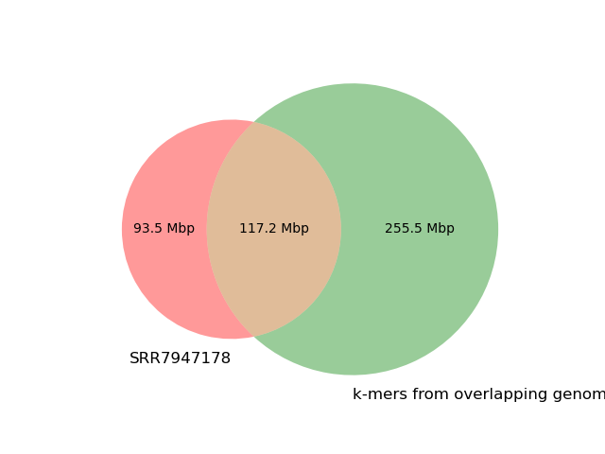
Overlaps – known and unknown!

Slide 53
What does this look like in practice??
SRR7947178, k=31, against GTDB rs214

Slide 54
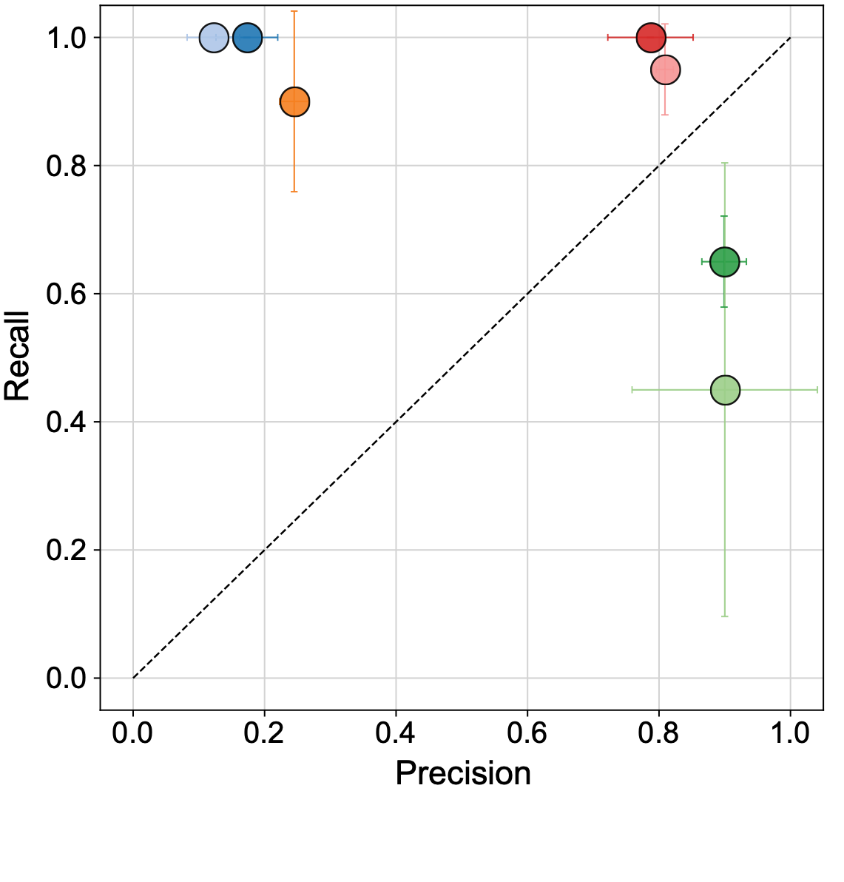
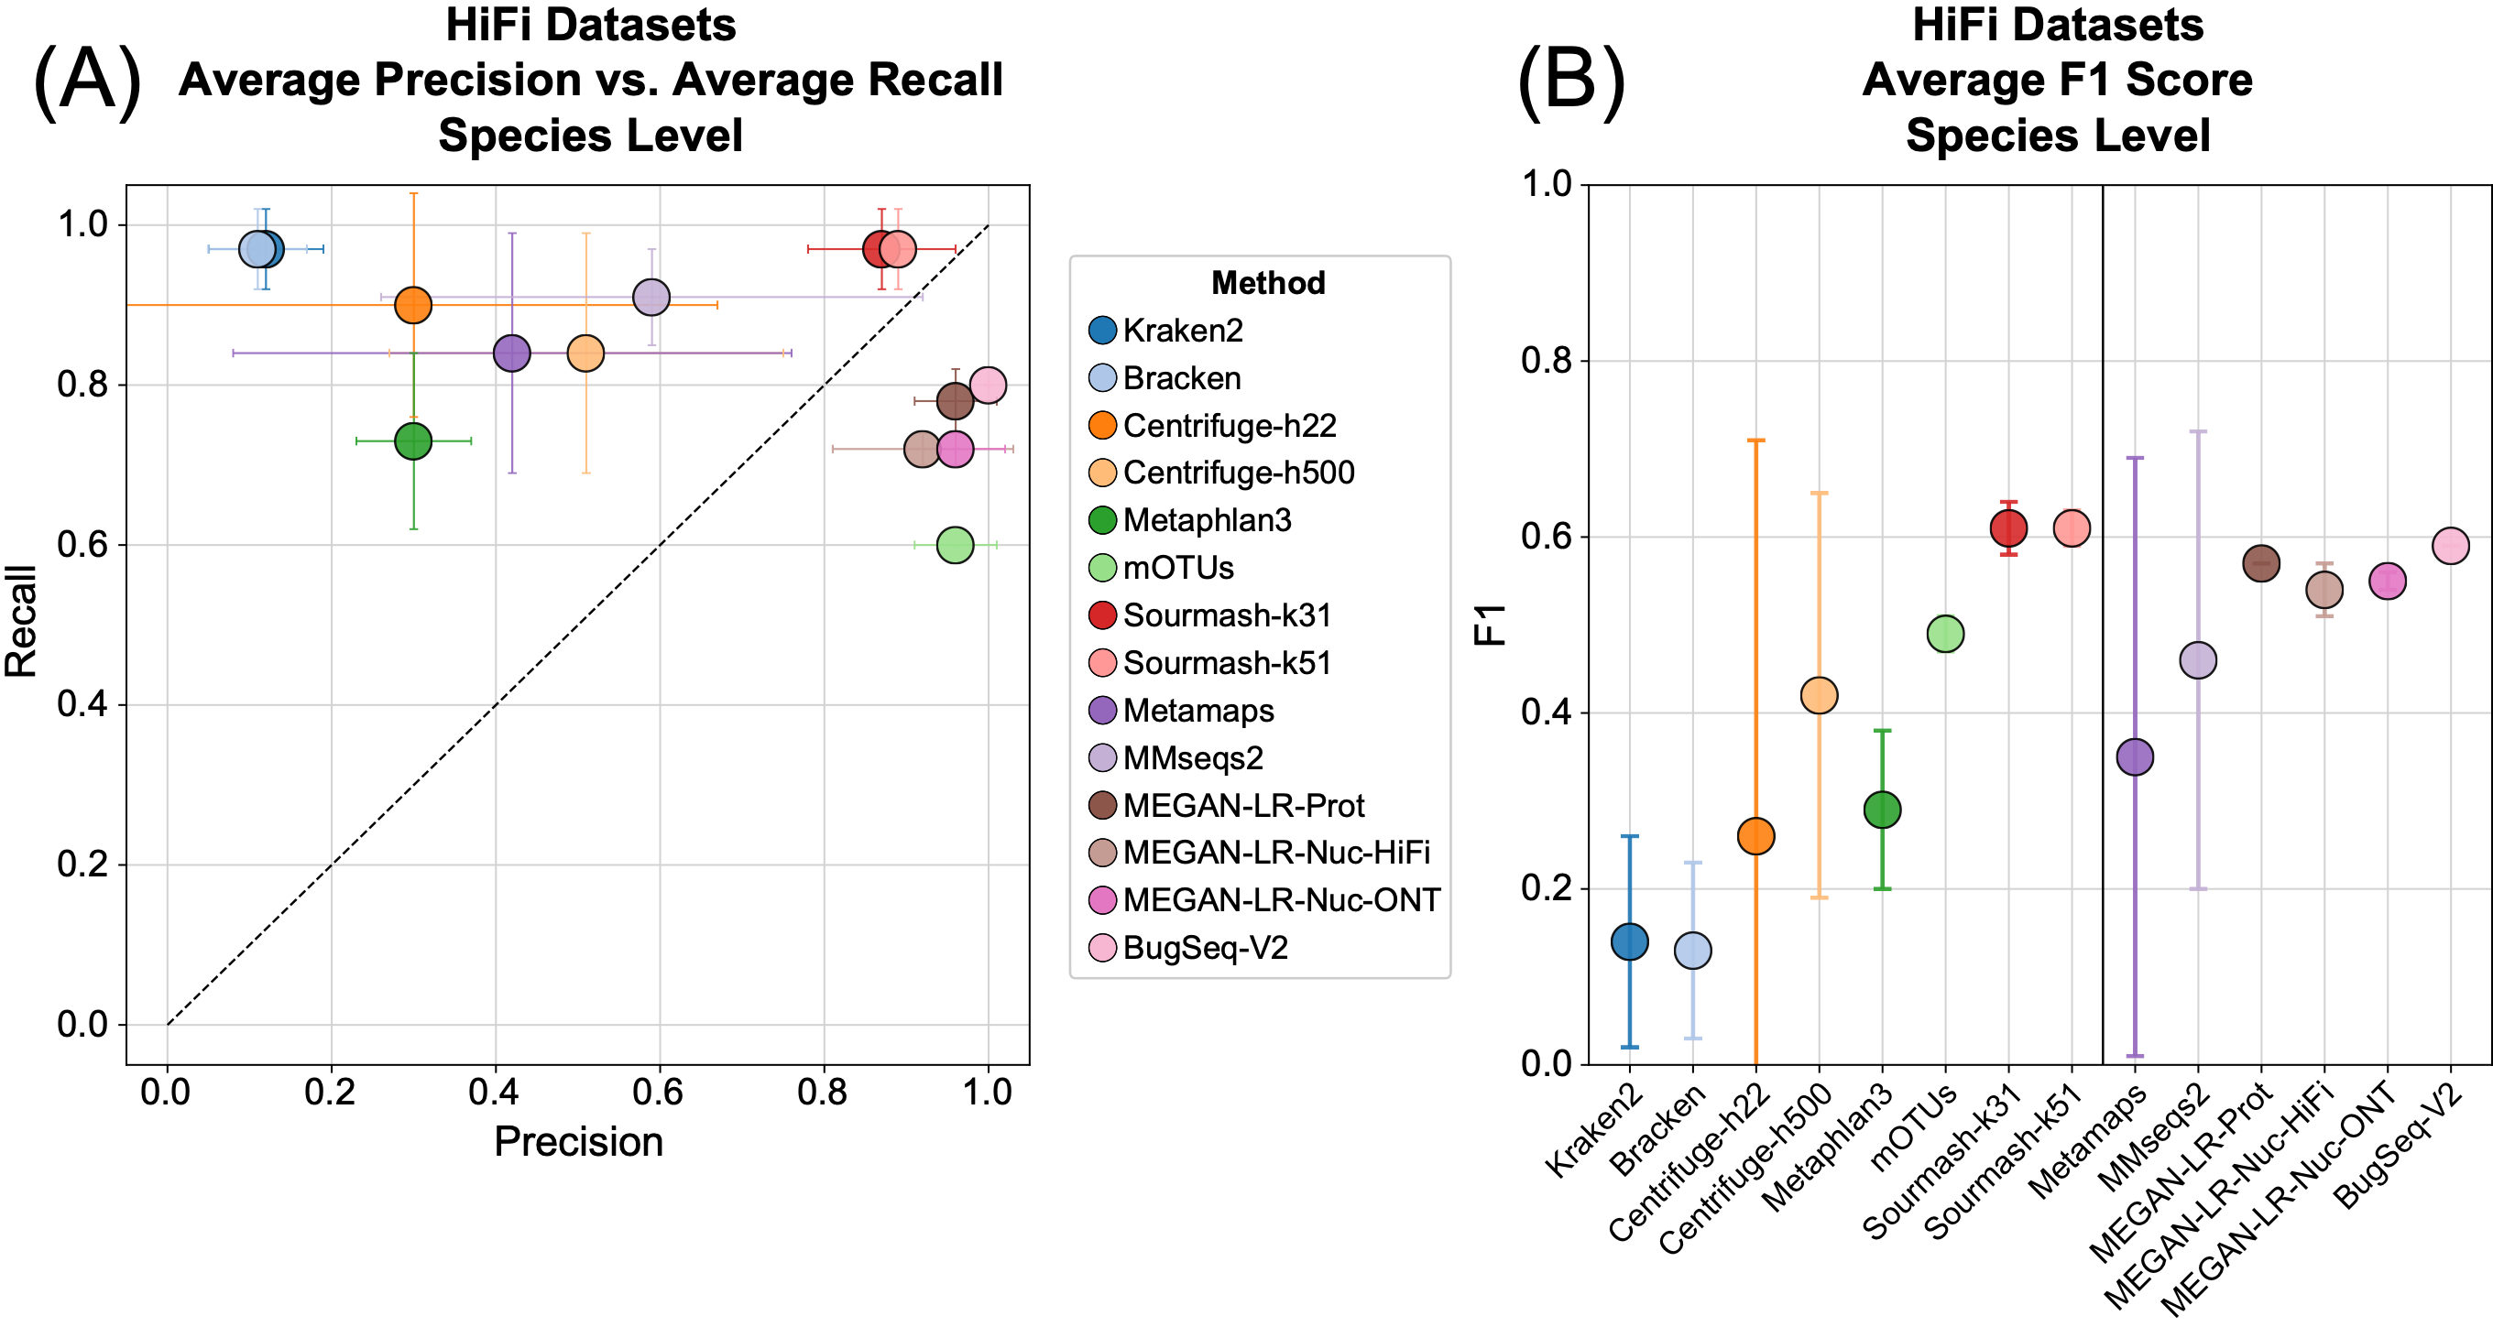
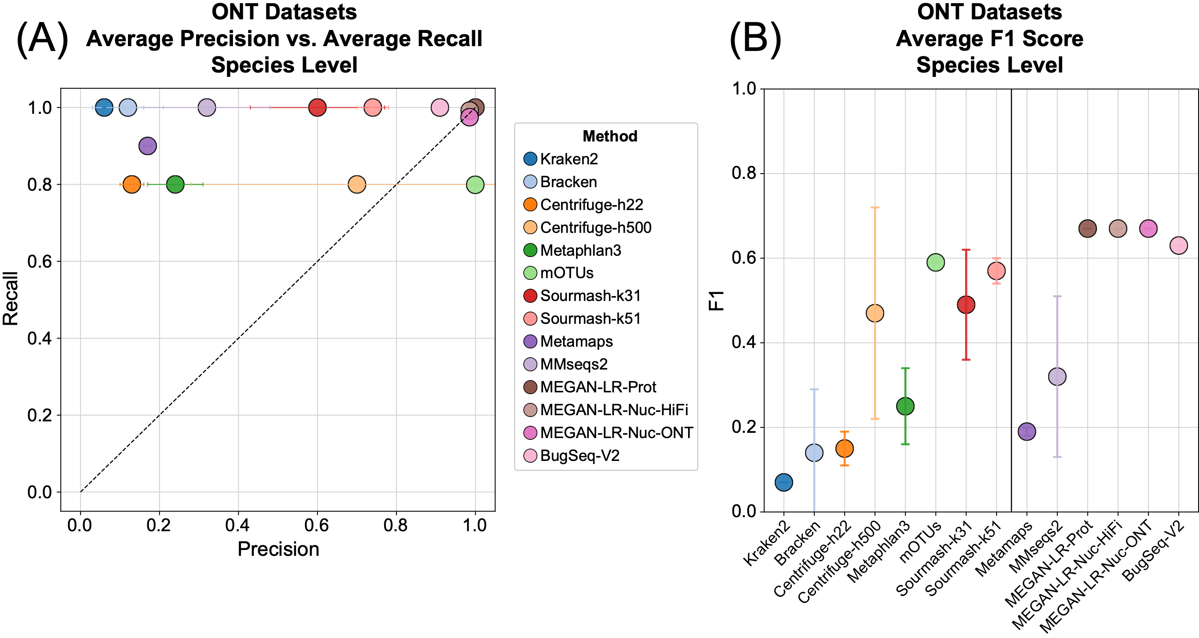
sourmash performs well for species-level taxonomic assignment.
I
Illumina
PacBio HiFi
ONT
Oxford Nanopore (R10.3, Q20)
Portik et al., 2022

Slide 55
How do we get to taxonomy??
There are 143 genomes from GTDB rs214 detected (via sourmash gather) in SRR7947178.
K=31, DNA. Abund.
Blue triangles: Ruminococcus
Red crosses: Bacteroides
Green circles: Alistipes

Slide 56
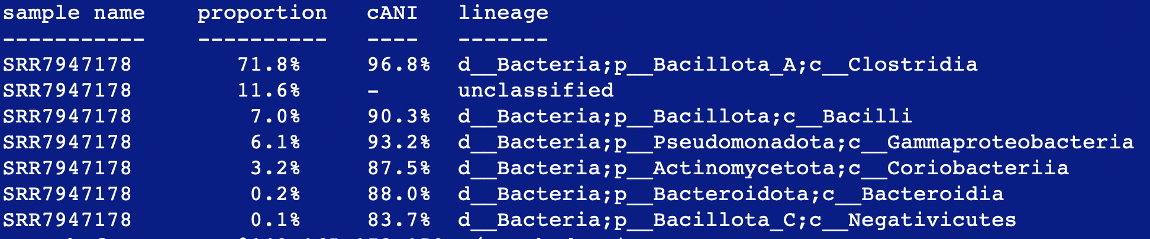
Sourmash taxonomy results.
Can use either NCBI or GTDB taxonomy; custom references; etc.

Slide 58
Some thoughts and concluding points
Some parts of metagenomes remain refractory to analysis against reference genomes and are simply “unknown”.
Error? Garbage? Unknown genomes, esp viruses & euks?
This includes accounting for assembly-based and MAG-based analysis!
If doing a reference-based analysis, always measure how much of your metagenome is unknown
Sourmash does this for you with ’sourmash gather’!
It’s a lower bound (i.e. the true number is always greater than what is reported by sourmash)
(Use the weighted number.)

Slide 59
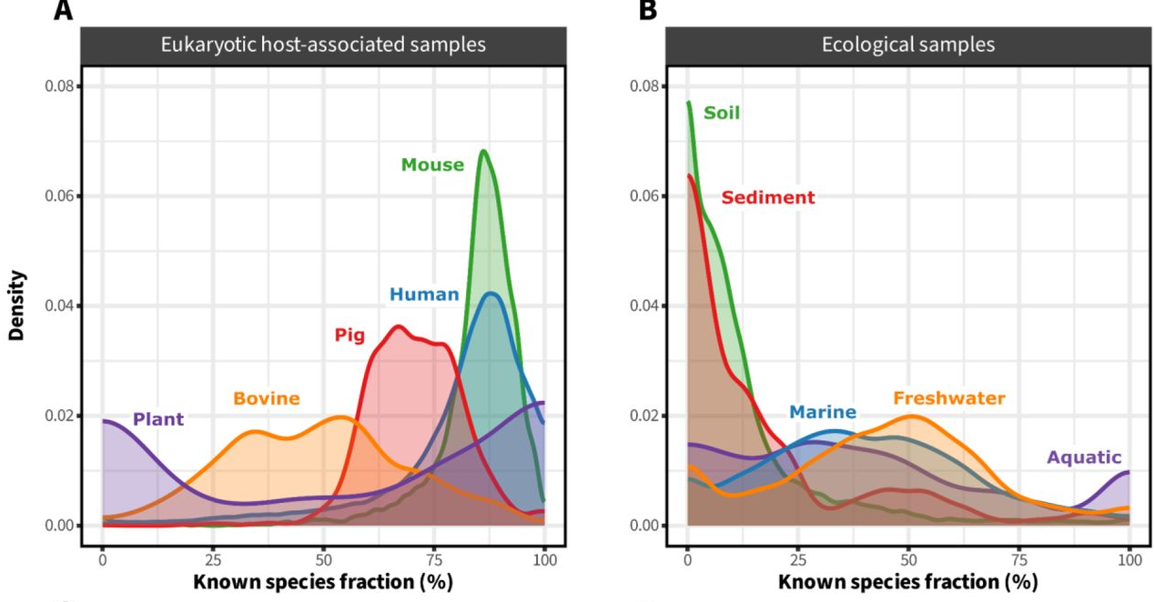
The landscape of metagenome classification
(Sandpiper & singleM are fantastic!!)
doi: 10.1101/2024.01.30.578060

Slide 60
Open Lab
You can run these programs and commands yourself, and be able to generate all the plots!
It is straightforward to run these on your own metagenomes of interest, as well as with adding your own collections of genomes.

